Slide 1
WEL-COME

Slide 2



Accredited by NACC B++ & An ISO 9001:2015 certified Institute
SANT GAJANAN MAHARAJ COLLEGE OF ENGINEERING
MAHAGAON
Department of Computer Science & Engineering
Academic Year 2019-20

Slide 3

Project Name: MEDICAL STORE MANAGEMENT SYSTEM Group members:- 1.Rokade Jyoti Chandrakant 2.Yesane Prajakta Sandip 3.Patil Sushama Shivgonda 4.Patil Gayatri Appasaheb Guide name:- Ms .A. P. Narayankar

Slide 4
INDEX
Abstract
Introduction
Existing system
Proposed system
Flowchart
Implementation
Results
Software & Hardware requirements
Advantages
Conclusion
References

Slide 5
ABSTRACT
Medical store system is used in medical shops and salesperson by providing the fully computerized data storage facility .
It help them to generate the bill and update the stock at the same time without any extra manual work.
This system will automatically update the record in all database as customer buys medicines.
It also help to owner to search an record of customer.
In this project database is contains the data of medicines.
It the discount to the customer which is already bought the medicines more time.

Slide 6
INTRODUCTION
Medical shop management requires user entry of container and product.
The system contains the information of medicines and their records.
This project will designed to implementation of medical store system.
The main focus will billing system ,that identifies whether the customer is eligible for discount or not.
This all will done by checking database for whether the customer is registered.

Slide 7
EXISTING SYSTEM
In previous system ,it can add the data but cannot modify it. There is no unique attribute to check it.
Multiple medicines cannot be checked for the customer.
In this system,there is problem for maintaining the record of daily transactions.as well as the record of medicines and customers.
Thay have work load so,thay they also have a problem dealing with their cutomers.
They have also problem in calculating of bills.

Slide 8
Proposed system
It provides the search technique of medicine by simply typing starting alphabate.
It also gives automatic validation of data during its sale and purchase.
It is able to detect the medicines that are near to expiry date.
This system provides the easy way to cashier to determine whether the customer is valid for discount or not.
This system is also helps to cashier for add and update the customer record as well as medicine record.

Slide 9
Start
Count=0
Flag=0
No
yes
Supplier info
Customer info
medicine
Report
Bill
Exit
No
Add
Update
Search
List of existing
Add
Search
Sale
Purchase
flag1=0
yes
No
n = sizeof(arr) / sizeof(arr[0]
gtotal=gtotal+bill.total.
No
Exit
yes
Fig 5.1 : Flowchart

Slide 10
Implementation
1) At the first step set the value of count=o and flag =o ,flag 1=0. In main function use the multiple switch case for each section
2) At the first by entering the first character of the operation the (file.dat ) will be in read mode . The pointer of reading file will not be stooped until the the pointer reaches the end of file condition(file.dat !=EOF).
3) If the condition (sid <0 || sid >1000) is true then id of supplier becomes 1and then
It closes the file. Otherwise the value of id becomes (id+1).,means it increases by one.
4) While updating the supplier is checks the condition (!readfile.eof()),if it is true then it again checks another condition(s1.id==id1).If this condition is true then it prints the record of existing suppliers , and then closes the reading file(for eg –file.dat).
5) In billing section there are two conditions are checked,at the first(!readfile.eof()).When this condition is true then it enter the next condition i.e(bill.custid==i).when it true then arr[j]=bill. billno..and the value of ‘j’ will increases.
6) At the last in sale billing if, flag1==0 then n = sizeof(arr) / sizeof(arr[0]) .and sets max=arr[0].if arr[i] > max ,then max = arr[i].and last for the calculation of discount the formula is gtotal=gtotal+bill.total.

Slide 11
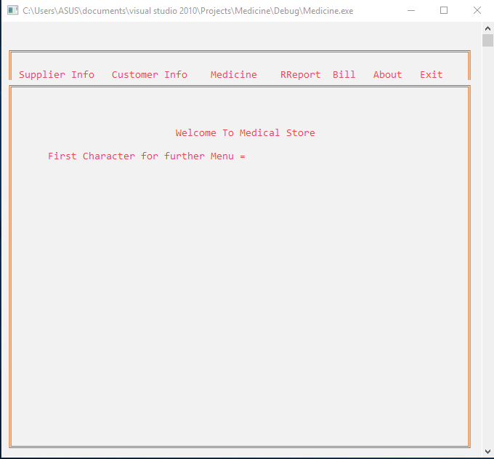
Results
fig 6.1 : Main Menu

Slide 12
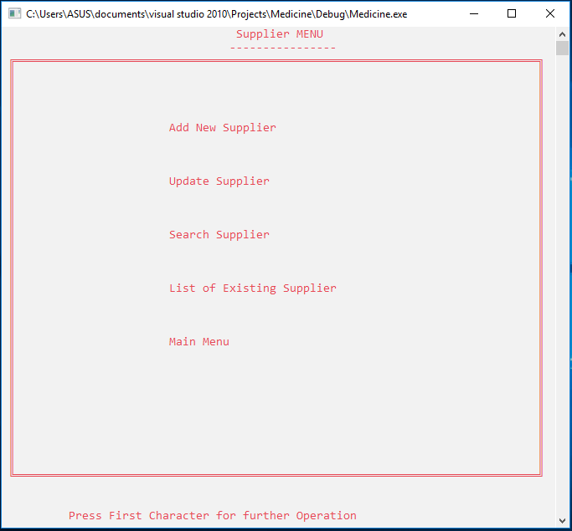
Fig 6.2 :before entering sample input1

Slide 13
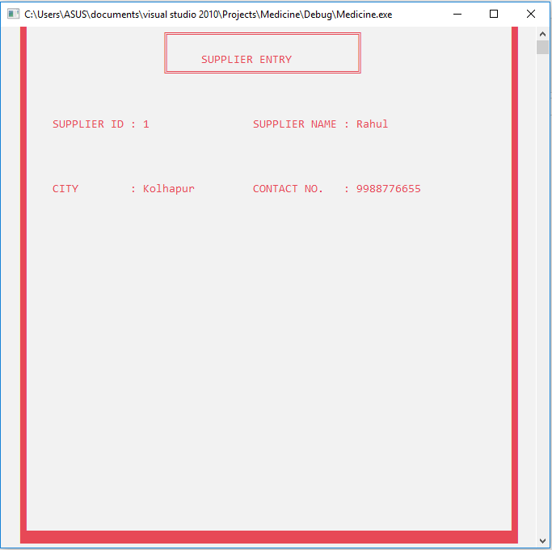
Fig 6.3 : After entering sample input 1

Slide 14
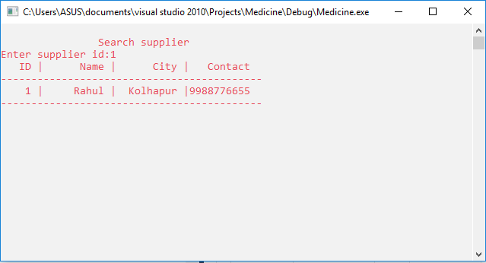
fig 6.4 : Sample output 1

Slide 15
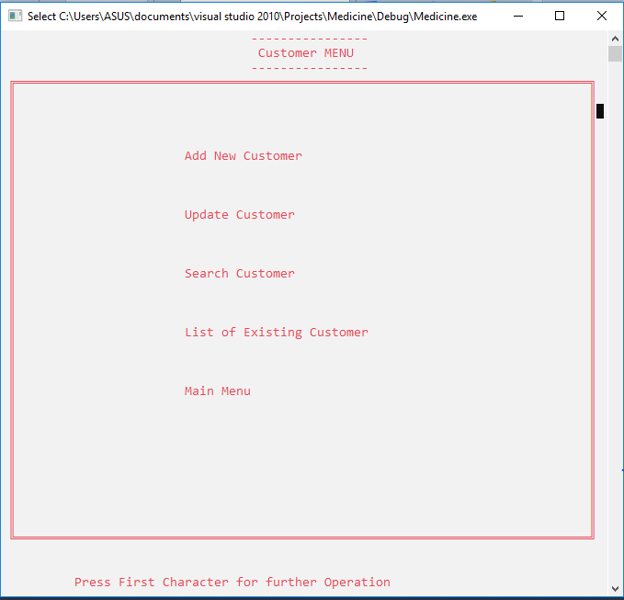
Fig 6.5 : before entering sample input 2

Slide 16
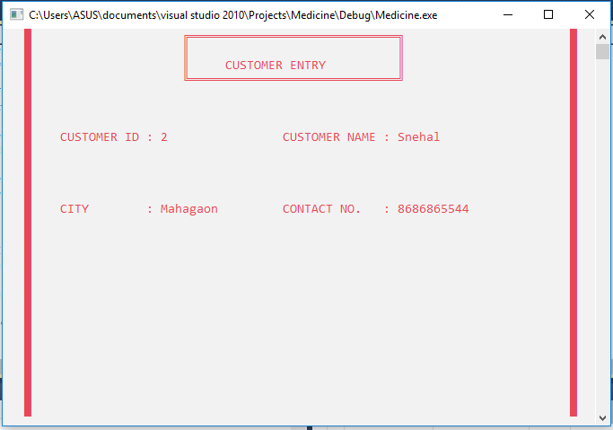
fig 6.6 : After entering sample input 2

Slide 17
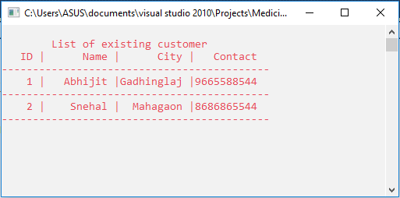
fig 6.7 : Sample output 2

Slide 18
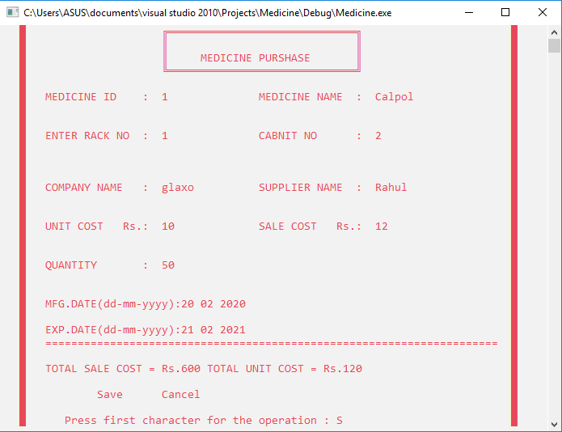
Fig 6.8: Medicine Purchase

Slide 19
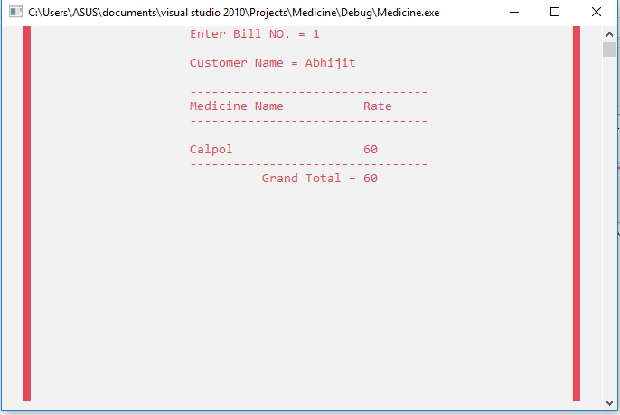
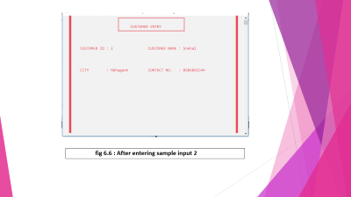
fig 6.9 : Bill Output

Slide 20
REQUIREMENTS
Software Requirements
OS:-Windows 7 or higher,ubuntu,
OS X v10.7 or higher
Compiler:-Dev C++,MS DOS,visual studio 10
Hardware Requirements
Processor:-Minimum 1GHz;Recommended 2GHZzor more
Memory(RAM):-Minimum 1Gb;Recommended 2GB or above
Hard Disk:-Minimum 32GB;Recommended 64GB or more

Slide 21
ADVANTAGES
This project will provides the searching facilities to the seller.
It reduces the complexity in billing and searching.
It will accuracy of input data ,means it will error free.
This system provides an easy way for the seller to determine whether the customer is a valid member, so that he can provide them with discount.
This system will helps to the casher to add or update new or existing accounts of members respectively.

Slide 22
CONCLUSION
By using “Medical shop management system”, the orders can be easily tracked and the report acts as a proof.
The order will be taken systematically and will be saved safely in the database rather than manually through paper work.
The operator can add, delete or update the records in the database with ease.
It requires less time and space to save the order details
It provides every small to big details like customer details, purchase details, sell details, bill details, etc.

Slide 23
REFERENCES
Web Reference:
https://www.codewithc.com
www.cppforschool.com
https://www.kashipara.com
https://projectabstracts.com
Book Reference:
Object-Oriented Programming with C++
By E Balgurusamy.

Slide 24
THANK YOU

